Slide 1
Vulnerability Management Lab
Vien Tran

Slide 2
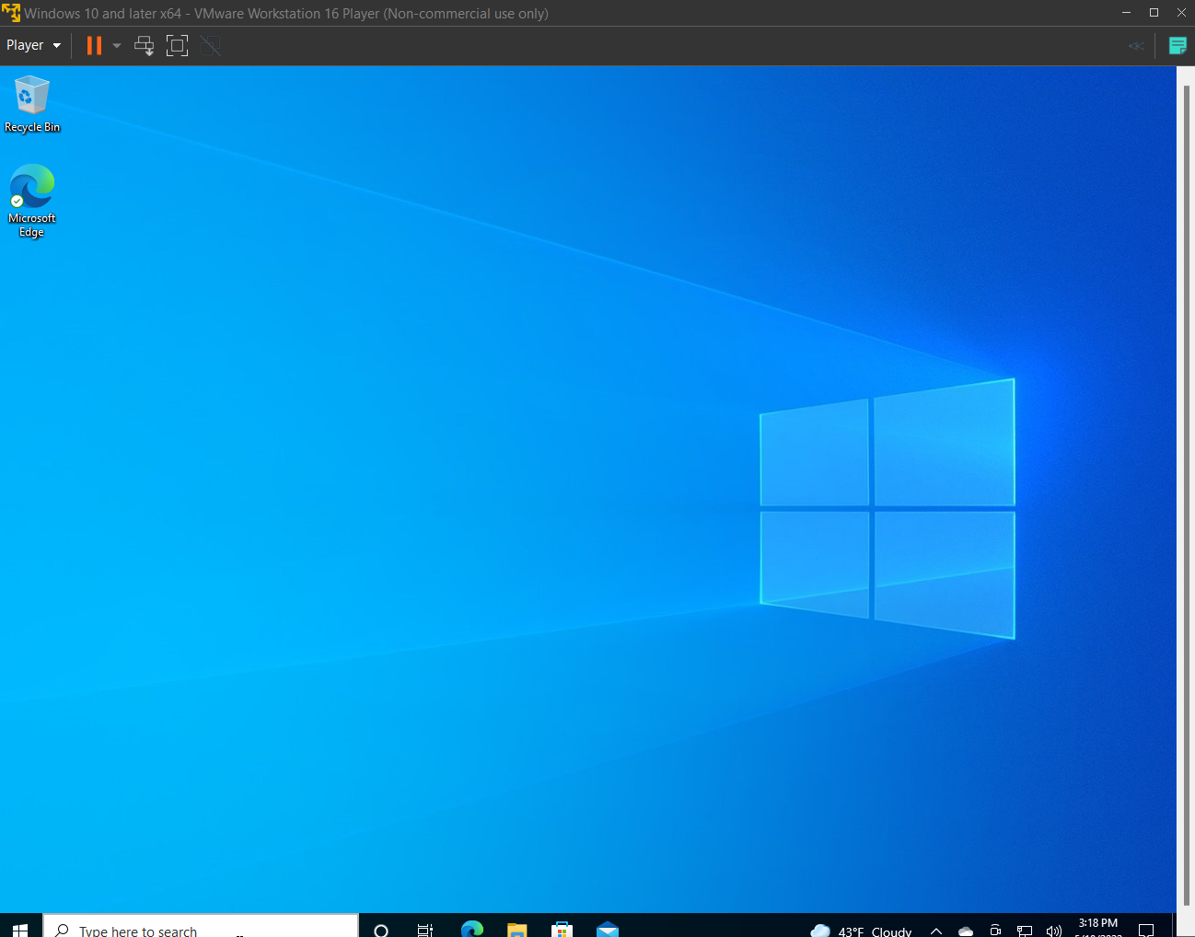
VM Desktop

Slide 3
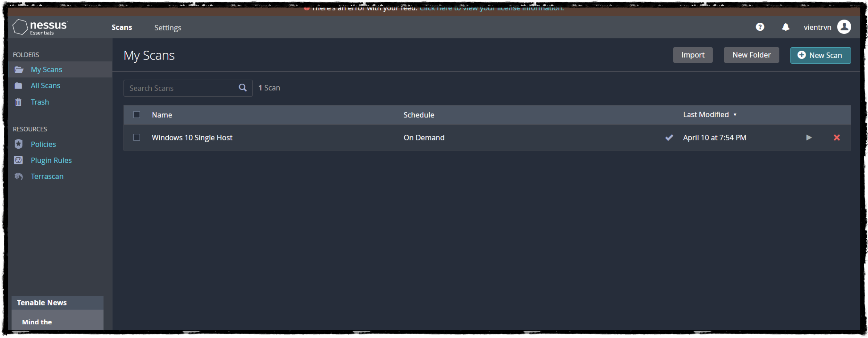
Tenable Nessus Home Page

Slide 4
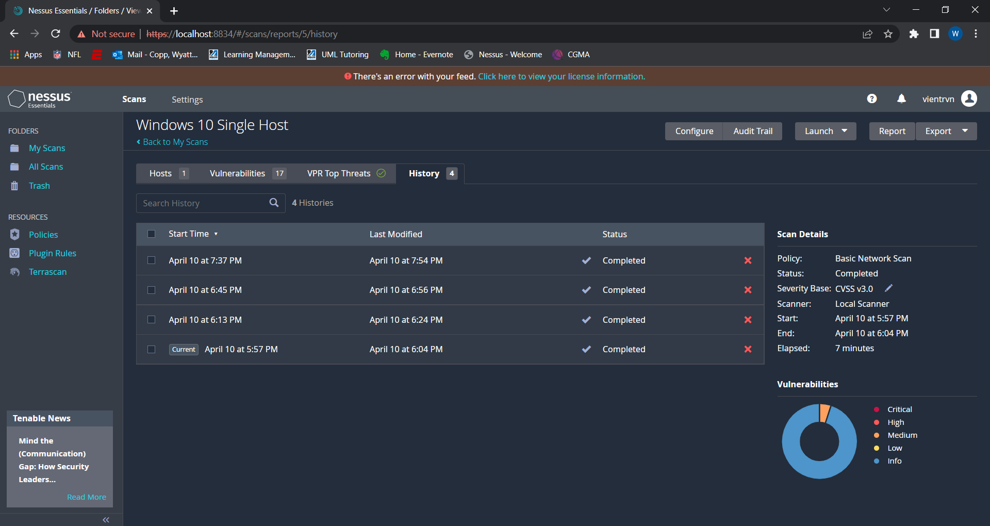

Slide 5
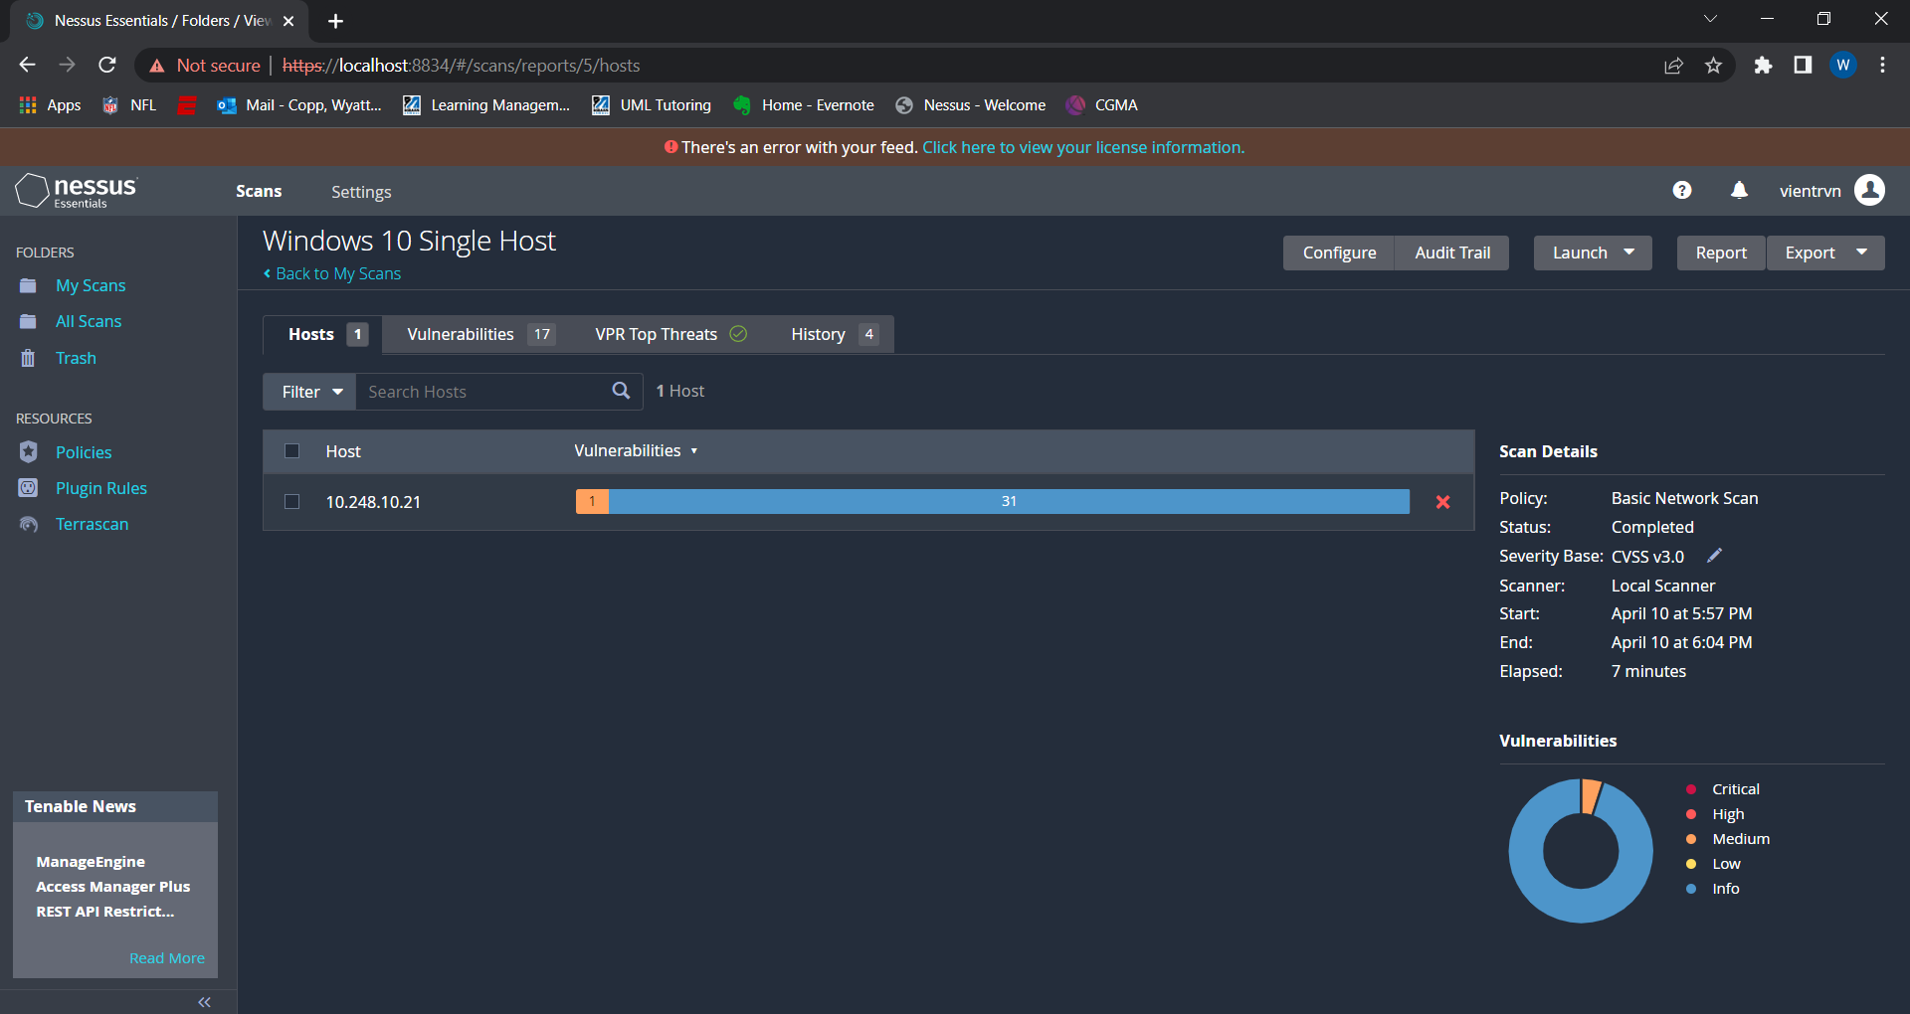

Slide 6
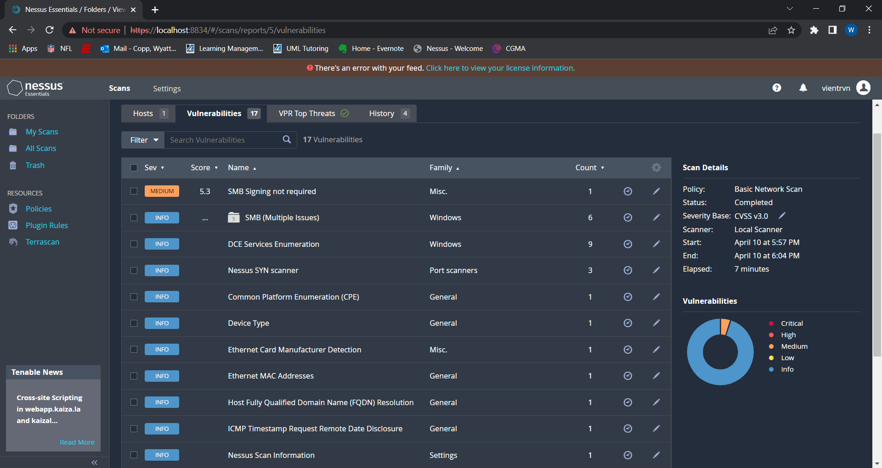
Notes:
- SMB stands for Server Message Block, a file sharing protocol in Windows, used to access shared folders on Windows machines
- SMB signing is security signature, part of a security mechanism in the SMB protocol
- By default this is always disabled or not required on remote server/ Can be fixed by going in the Local Group Policy

Slide 7
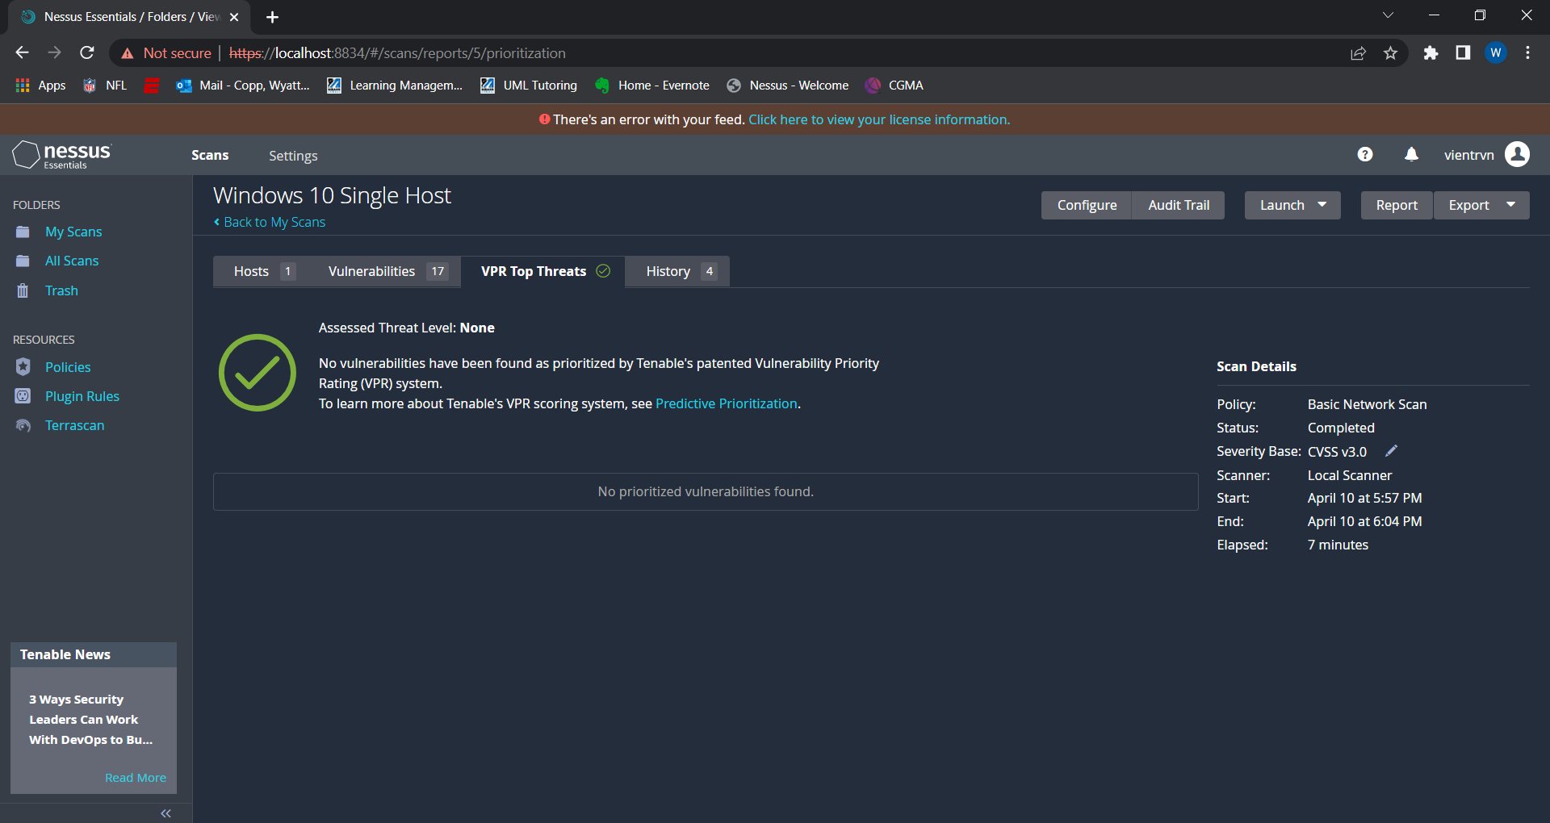
Notes:
- VPR stands for Vulnerability Priority Rating give a score from 0.1-10.0 for the likelihood of exploit

Slide 8
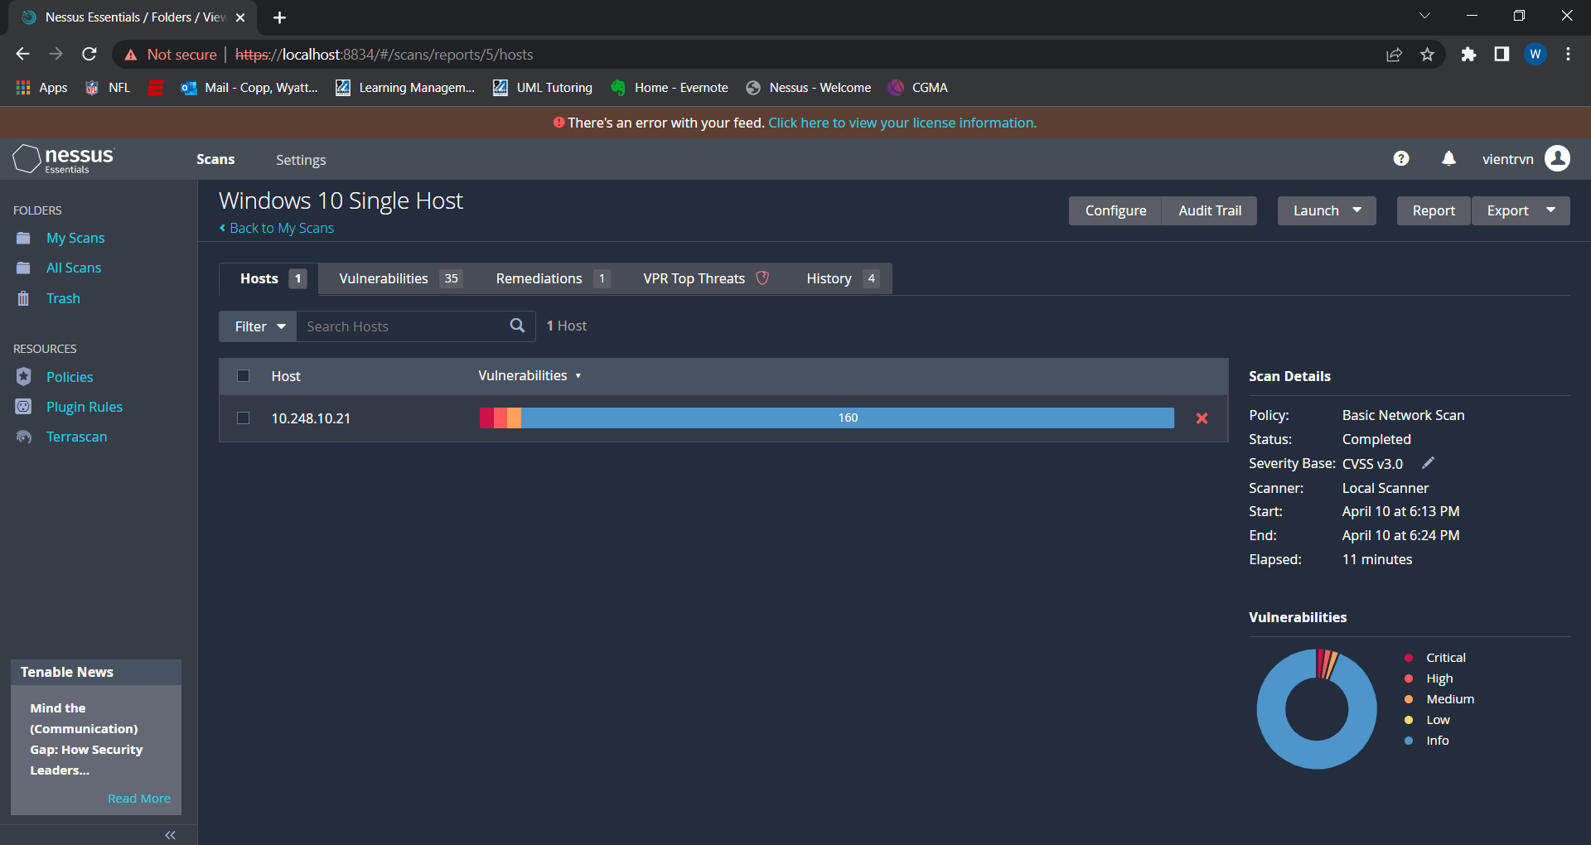

Slide 9
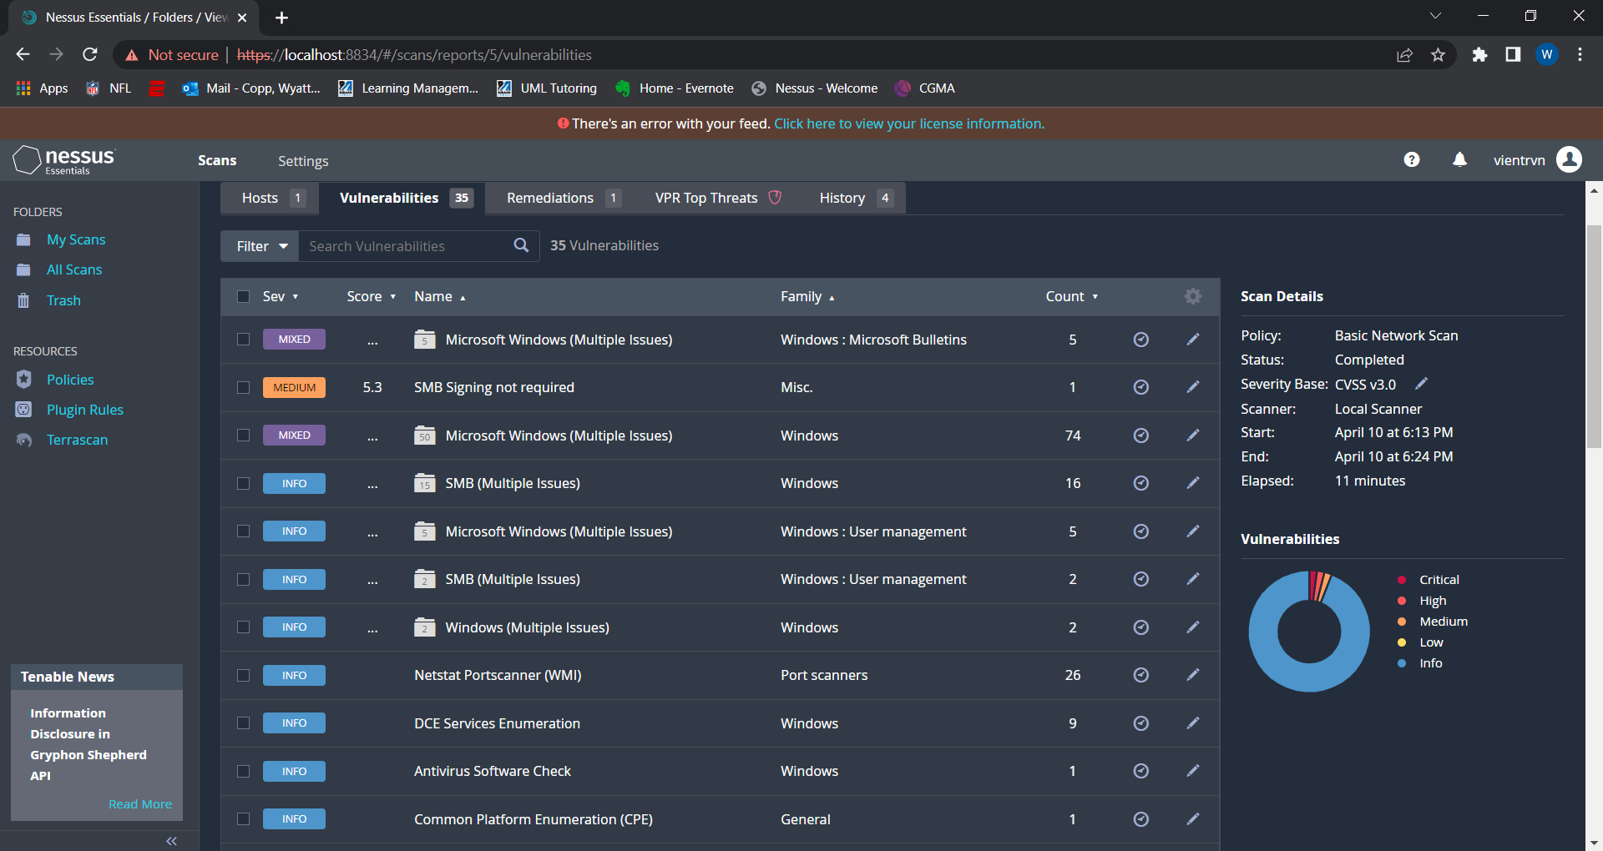

Slide 10
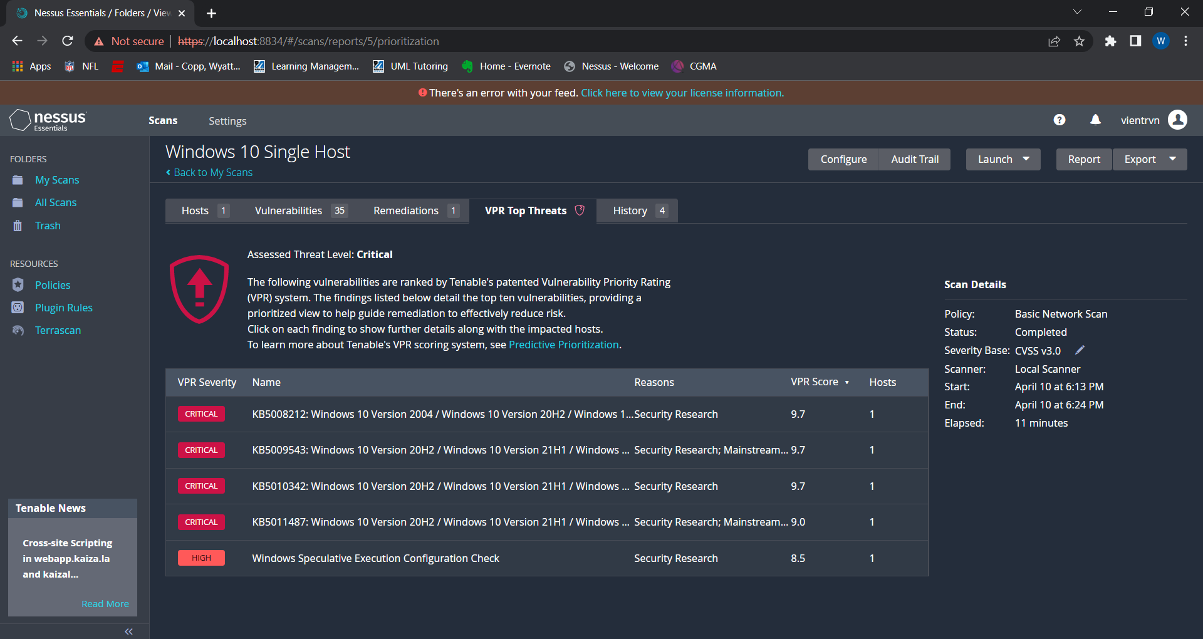
Notes:
KB5011487 is an Dynamic Cumulative Update package for Windows 10 Version 21H2
Windows Speculative Execution Configuration Check is telling you to check for vulnerabilities in a comp sys in which a speculative execution optimization implemented in a microprocessor is exploited to leak secret data to an unauthorized party

Slide 11
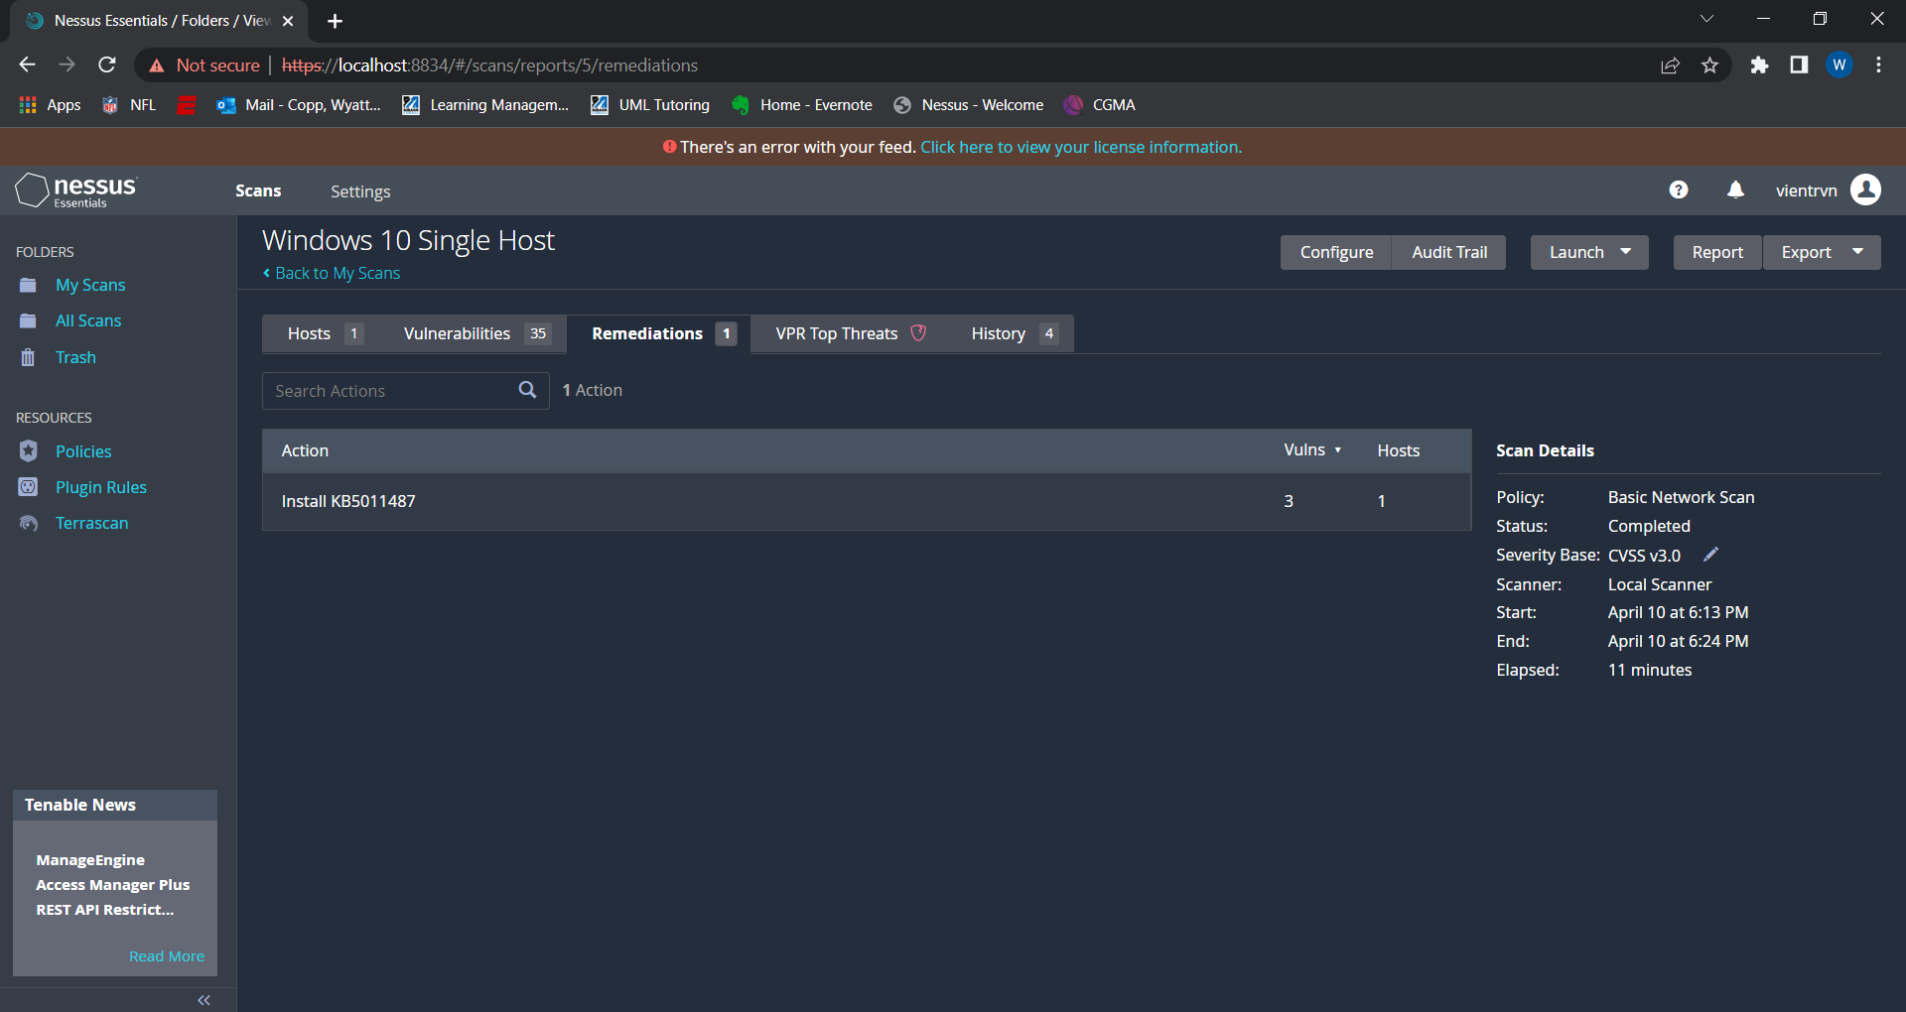

Slide 12
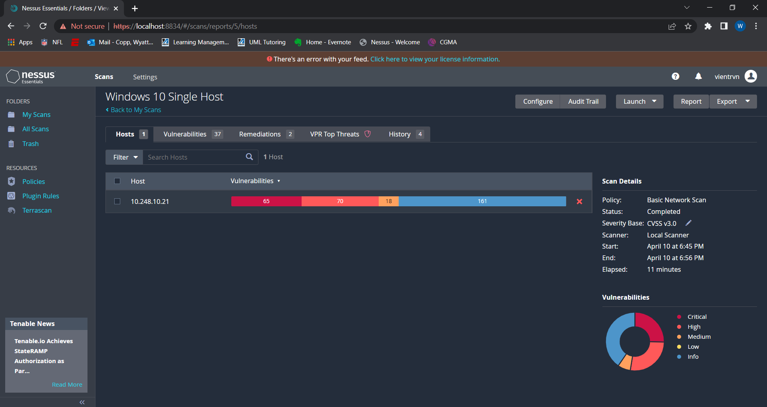

Slide 13
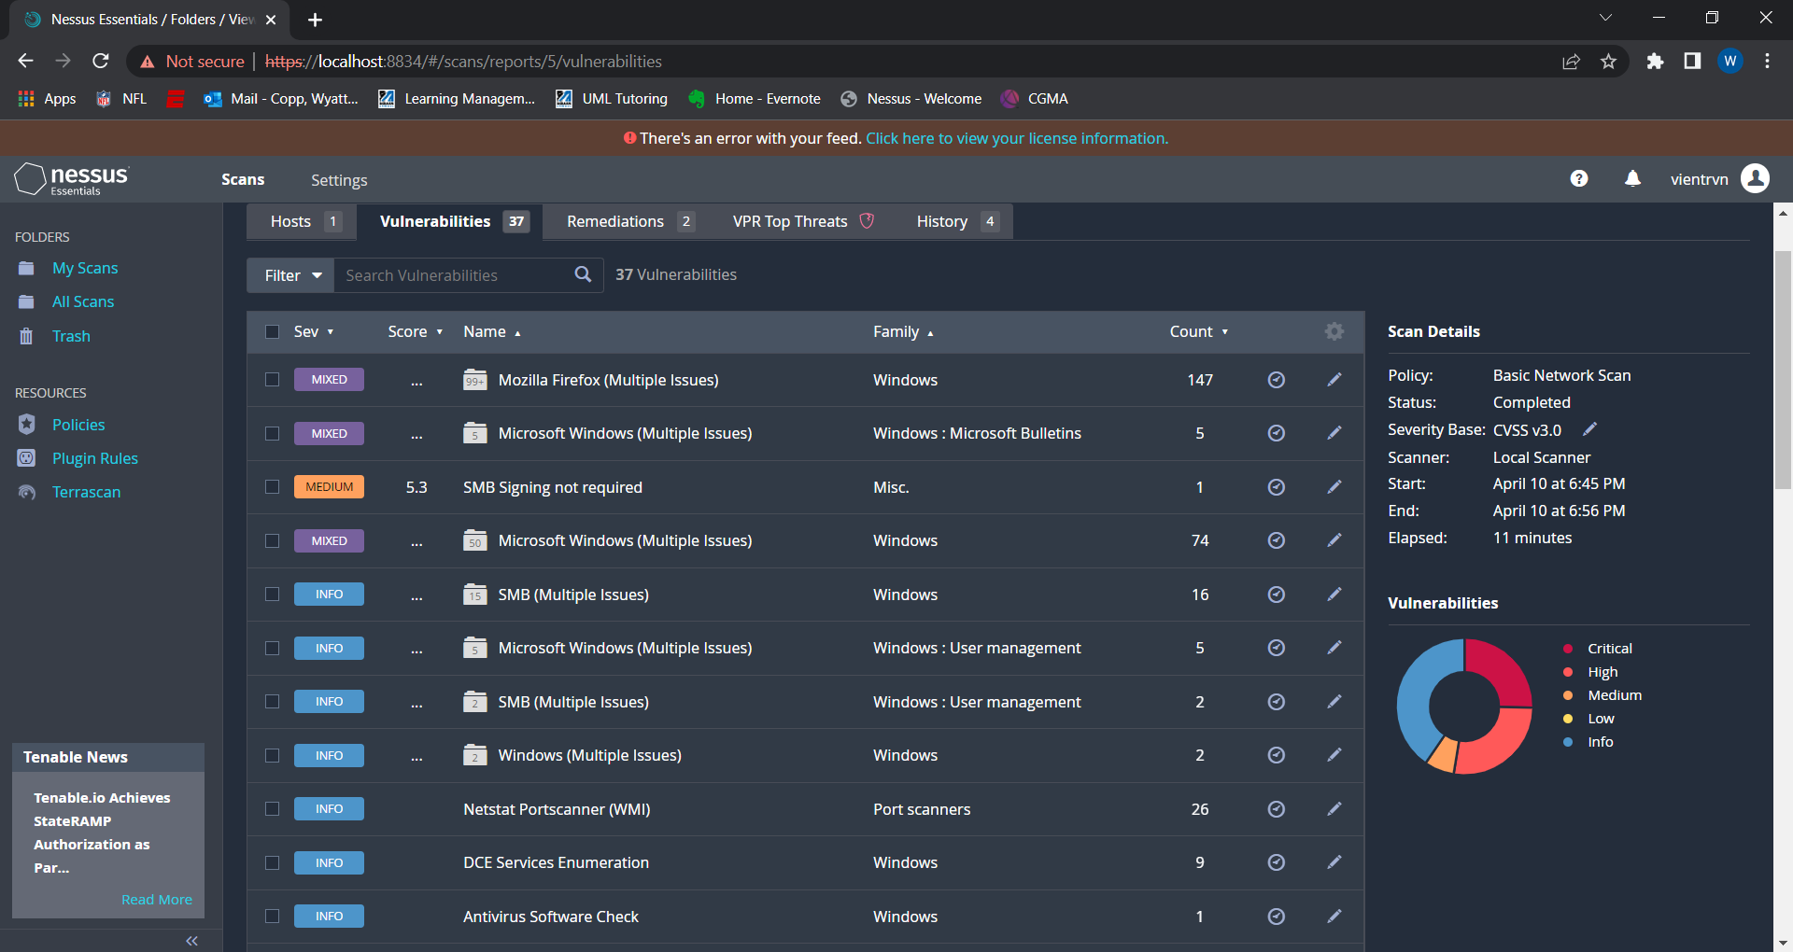

Slide 14
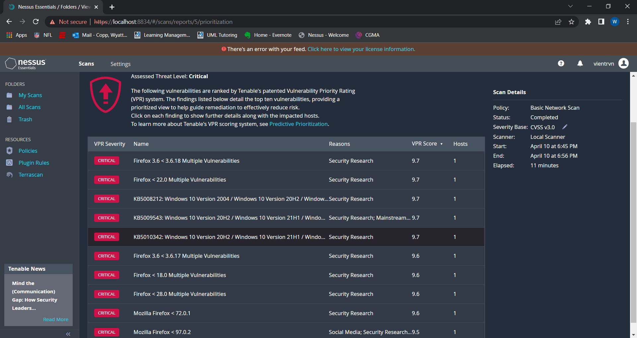

Slide 15
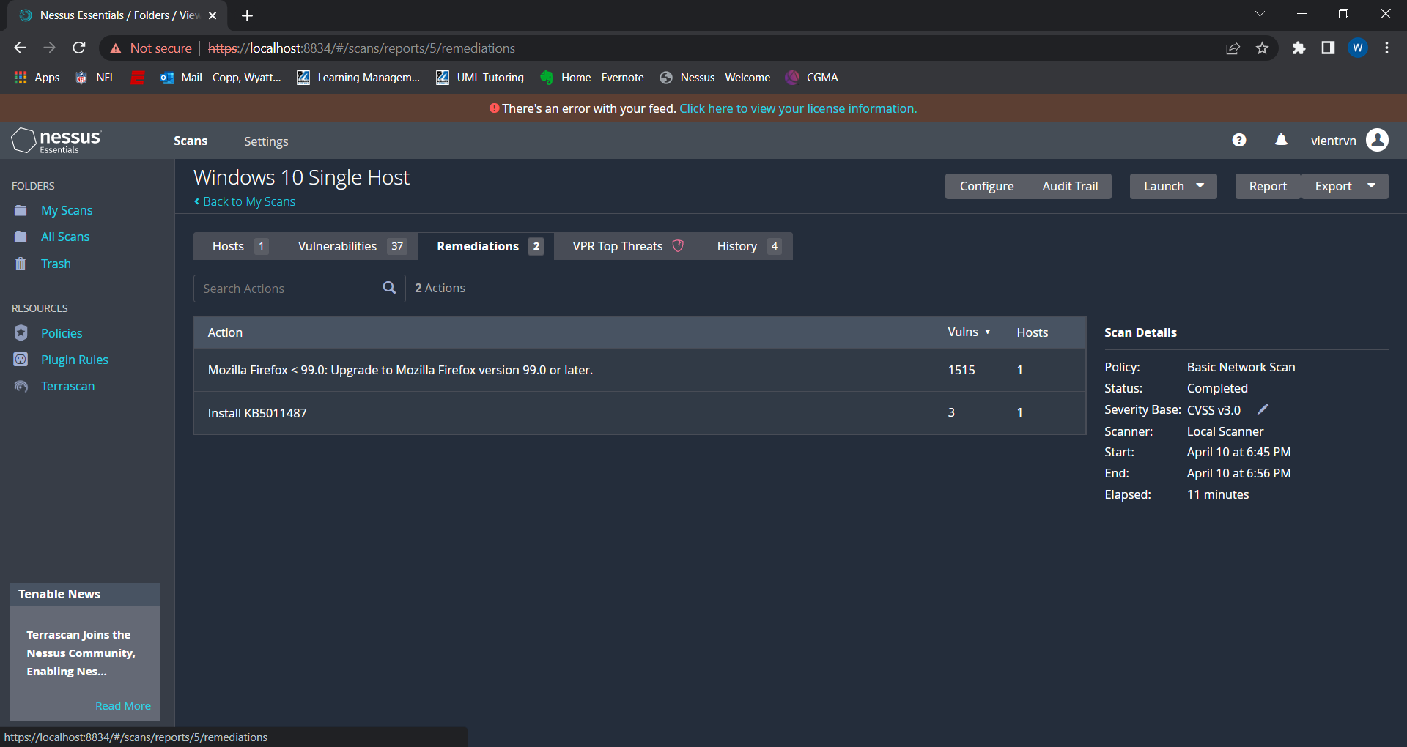

Slide 16
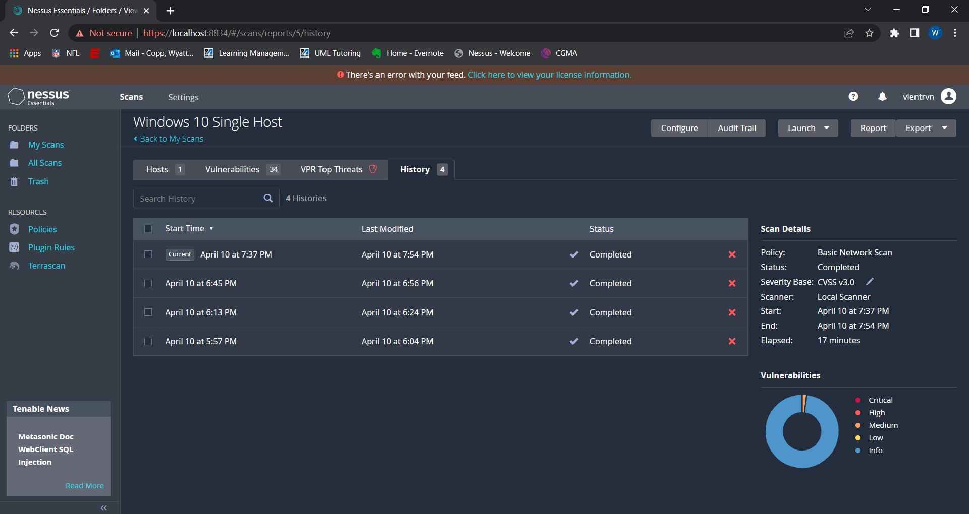

Slide 17
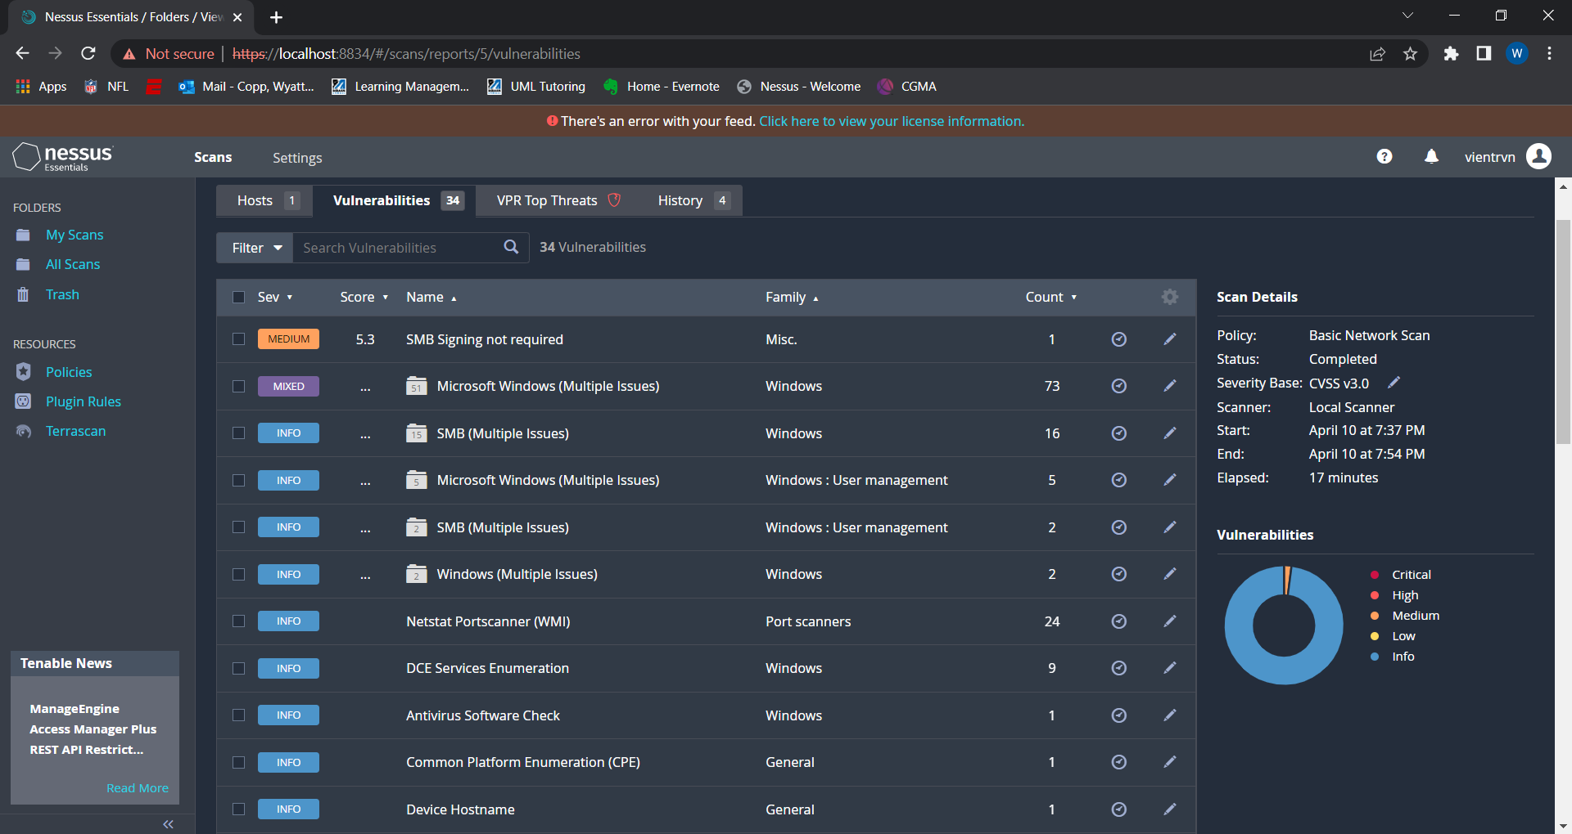

Slide 18
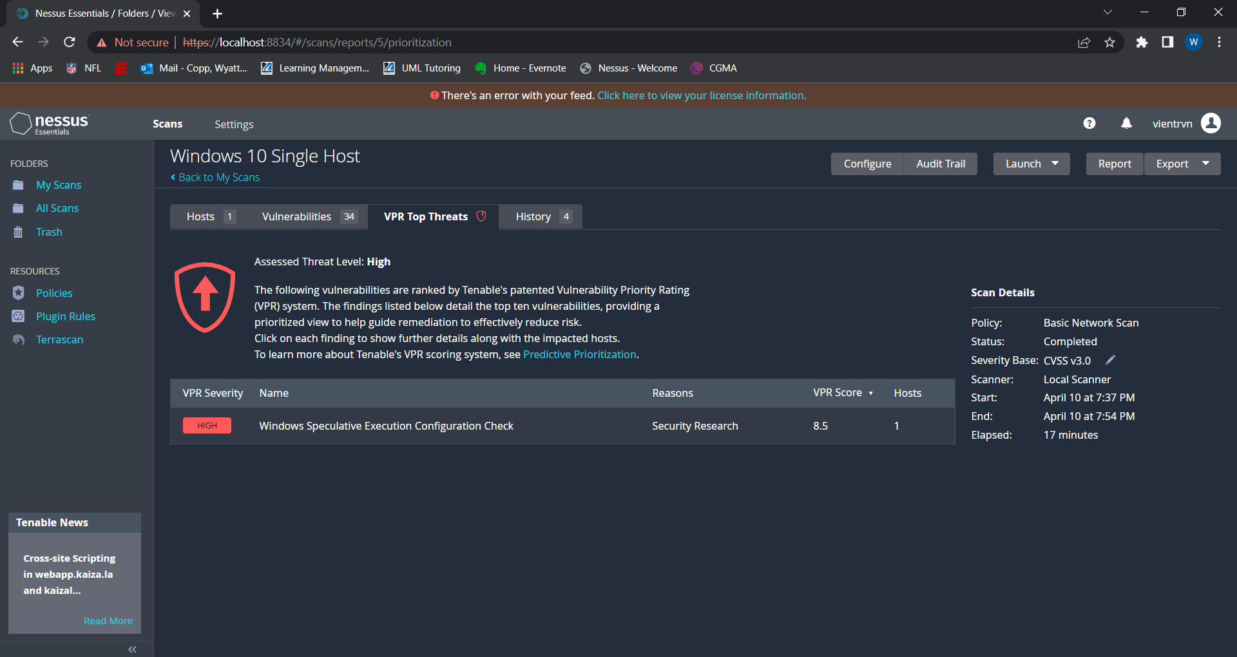

Slide 19
Thank you

